Slide 1
CPS-101 ICT Fundamentals
Lecture - 3
Lecturer Rabia Khan

Slide 2
How Computers Represent Data
Number systems
  A manner of counting
  Several different number systems exist
Decimal number system
  Used by humans to count
  Contains ten distinct digits
  Digits combine to make larger numbers

Slide 3
How Computers Represent Data
Binary number system
  Used by computers to count
  Two distinct digits, 0 and 1
  0 and 1 combine to make numbers
Notes:
Teaching Tip
Table 5A.1 on page 187 provides the first 17 binary numbers and their decimal equivalent. A fun exercise is to teach the students to count in binary on their fingers.

Slide 4
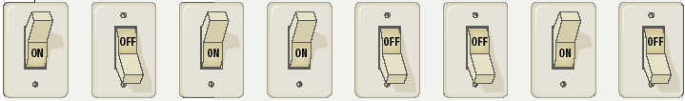
How Computers Represent Data
Bits and bytes
  Binary numbers are made of bits
  Bit represents a switch
  A byte is 8 bits
  Byte represents one character

Slide 5
How Computers Represent Data
Text codes
  Converts letters into binary
  Standard codes necessary for data transfer
  ASCII
    American English symbols
  Extended ASCII
    Graphics and other symbols
  Unicode (32 bits= 4 billion characters)
    All languages on the planet
    Chinese, Korean and Japanese character sets

Slide 6
How Computers Process Data
The CPU
  Central Processing Unit
  Brain of the computer
  Control unit
    Controls resources in computer (like a traffic signal)
    Instruction set
  Arithmetic logic unit
    Simple math operations
    Registers
    The ALU is an internal part of the processor which is used for all mathematical and logical operations. The basic operations of an ALU include adding and multiplying binary values, as well as performing logical operations such as AND, OR and XOR. The algorithms for performing these mathematical and logical operations are hard coded (stored permanently) within the ALU.

Slide 7
How Computers Process Data
Machine cycles
  Steps by CPU to process data
  Instruction cycle (Fetching + Decoding)
    CPU gets the instruction
  Execution cycle (Executing + Storing)
    CPU performs the instruction
  Measured in MIPS or BIPS (Billions of cycles per second)
  Multitasking allows multiple instructions
Notes:
Most processors endlessly repeat three basic steps. Each machine cycle results in the execution of one machine instruction. A modern processor performs millions of machine cycles per second.
A machine instruction is a pattern of bits that corresponds to a fundamental operation of the processor such as adding two 32-bit integers together or testing if a value is zero. The details of the machine cycle differ between processor families. The machine cycle of most processor chips looks like the following:
Fetch the Instruction. The instruction is fetched from memory. The program counter (PC) is part of the processor. It shows where the instruction is located in memory.
Increment the Program Counter. The program counter now points to the next instruction.
Execute the Instruction. The operation asked for by the current machine instruction is performed.

Slide 8
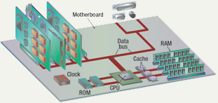
Components affecting Speed

Slide 9
Factors Affecting Processing Speed
Registers
  Part of processor, not RAM
  When the processor executes instructions, data is temporarily stored in small, local memory locations of 8, 16, 32 or 64 bits called registers.
  Number of bits processor can handle
  A register may hold a computer instruction , a storage address, or any kind of data (such as a bit sequence or individual characters)
  Word size
  Larger indicates more powerful computer
  Processor registers are at the top of the memory hierarchy, and provide the fastest way for a CPU to access data.

Slide 10
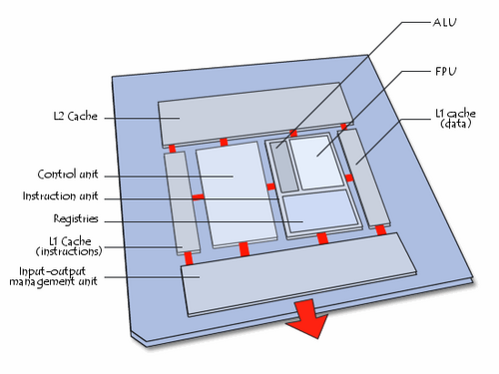
Elements Making up a Processor

Slide 11
Factors Affecting Processing Speed
Virtual RAM
  Computer is out of actual RAM
  File that emulates RAM
  Computer swaps data to virtual RAM
    Least recently used data is moved

Slide 12
Factors Affecting Processing Speed
The computer’s internal clock
  Quartz crystal to time the processing operations
  Every tick causes a cycle
  With each clock cycle, the processor performs an action that corresponds to an instruction (approx)
  Speeds measured in Hertz (Hz)
    Modern machines use Giga Hertz (GHz)
  1 MHz means millions of cycles per second
  As the computer’s clock speed increases, so does the number of instructions executed per second

Slide 13
Factors Affecting Processing Speed
The Bus
  Electronic pathway between components
  Internal Bus , External (Expansion) Bus
  Expansion bus connects to peripherals
  Bus width is measured in bits
  Data Bus (32 bits bus, 64 bit bus)
  Address Bus
  Bus speed measured in MHz (MegaHertz)

Slide 14
Factors Affecting Processing Speed
Cache memory
  Very fast memory
  Holds common or recently used data
  Speeds up computer processing
  Most computers have several caches
  L1 holds recently used data
  L2 holds upcoming data
  L3 holds possible upcoming data

Slide 15
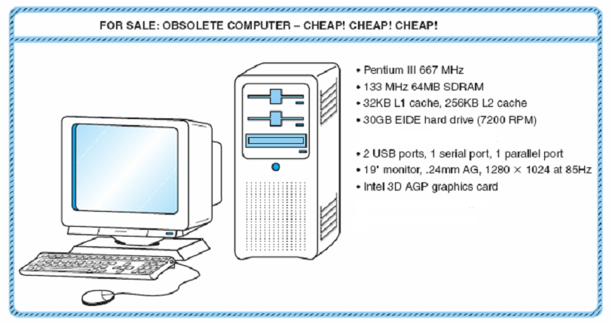
An Example System: Computer Specific Vocabulary
A Typical Computer Advertisement

Slide 16
An Example System
Pentium III 667MHz
  The microprocessor in the ad is a Pentium III, operating at 667MHz.
  The microprocessor is the part of a computer that actually executes program instructions; it is the brain of the system.
  Every computer system contains a clock that keeps the system synchronized.
  The number of pulses emitted each second by the clock is its frequency measured in cycles per second or Hertz (Hz).
  The frequency rating of the microprocessor is crucial to overall system speed.

Slide 17
An Example System
133MHz 64MB SDRAM
  The 133MHz refers to the speed of the system bus.
  Bus speed sets the upper limit on the system’s information-carrying capability.
  A memory capacity of 64 megabytes (MB), or about 64 million characters.
  Memory capacity not only determines the size of the programs that you can run, but also how many programs you can run at the same time.
  A memory type, SDRAM (synchronous dynamic random access memory).
  SDRAM is much faster than conventional memory because it can synchronize itself with a microprocessor’s bus.

Slide 18
An Example System
32KB L1 cache, 256KB L2 cache
  No matter how fast a bus is, it still takes a while to get data from memory to the processor. To provide even faster access to data, a special memory called cache is used.
  Here two kinds of cache.
  Level 1 cache (L1) is a small, fast memory cache that is built into the microprocessor chip and helps speed up access to frequently used data.
  Level 2 cache (L2) is a collection of fast, built-in memory chips situated between the microprocessor and main memory.

Slide 19
An Example System
30GB EIDE hard drive (7200 RPM)
  The storage capacity of fixed (or hard) disk is 30GB.
  However a large disk isn’t very helpful if it is too slow for its host system.
  The hard drive rotates at 7200 RPM (revolutions per minute).
  Usually disk speeds are stated in terms of the number of milliseconds required (on average) to access data on the disk, in addition to how fast the disk rotates.
  Disk interface EIDE, or enhanced integrated drive electronics which describes how it connects to or interfaces with the rest of the system.

Slide 20
An Example System
2 USB ports, 1 serial port, 1 parallel port
  Ports allow movement of data to and from devices external to the computer.
  Serial ports transfer data by sending a series of pulses across one or two data lines.
  Parallel ports use at least eight data lines, which are energized simultaneously to transmit data.
  USB is a popular serial connection that supports Plug-and-Play (the ability to configure devices automatically and to add and remove devices while the computer is running).

Slide 21
An Example System
19" monitor, .24mm AG, 1280x1024 at 85Hz
  Monitors have little to do with the speed or efficiency of a computer system, but they have great bearing on the comfort of the user.
  A refresh rate of 85Hz → image displayed on the monitor is repainted 85 times a second.
  A resolution of 1280x1024 → No. of dots/pixels horizontally x No. of pixels vertically.
Intel 3D AGP graphics card
  This monitor is supported by an AGP (accelerated graphics port) graphics card.
  A graphics interface designed specifically for 3D graphics.

